Slide 1
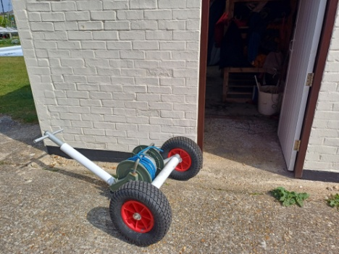
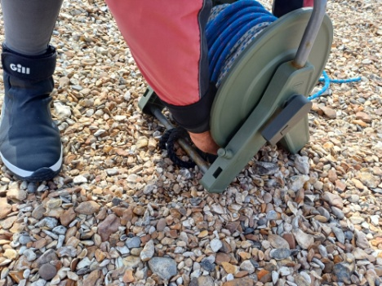
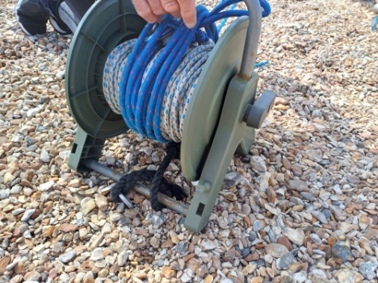
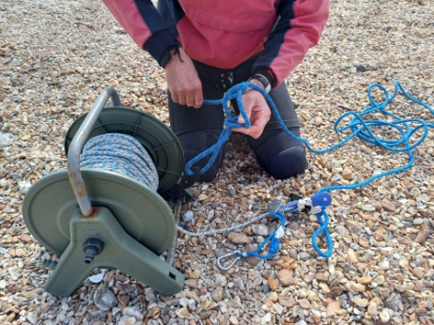
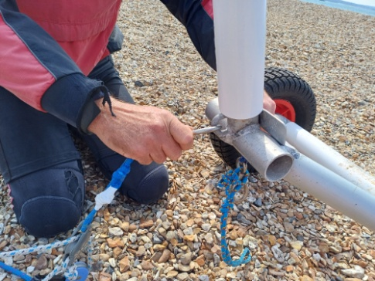
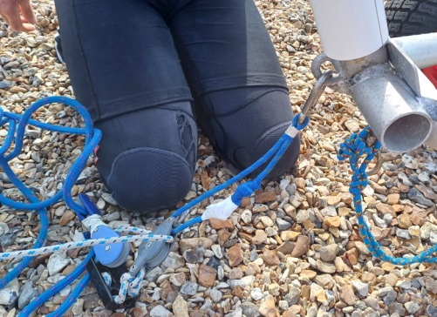
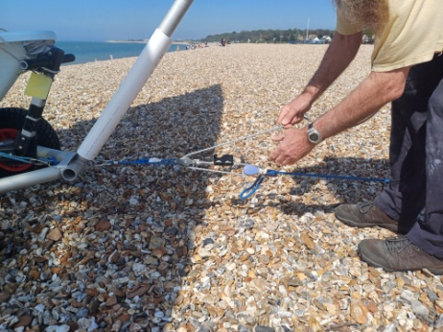
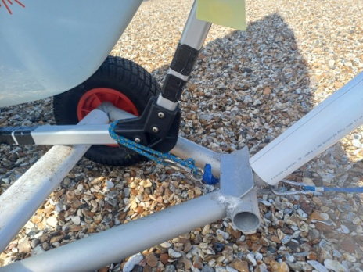
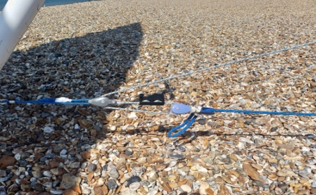
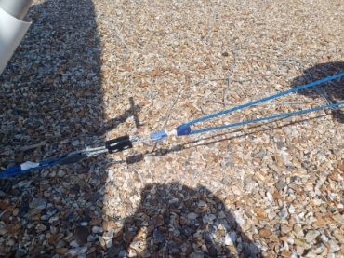
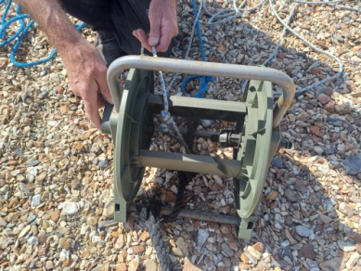
Using the Trolley Buggy to aid self-recovery of dinghies
Start! Buggy & tackle reel kept in west store
Step 1 Secure reel to ramp strop at top of slipway
Step 2 Ramp strop fed underneath reel towards the sea
Step 3 Secure ramp strop to blue line with a bowline
Step 4 Using snap shackle attach tackle to buggy
Step 5 With thick blue line set the reach down the beach
Step 6 With both lines extended, bring trolley buggy to meet your boat trolley
Step 7 Attach trolley buggy to boat trolley
Step 8 Pull in the blue/ white line
Step 9 Secure blue/white line to black cleat for 3 part purchase
Step 10 Once boat is recovered, rewind blue/white line onto reel ready for next user
Finish - Return Trolley Buggy to west store
A catamaran version of this, is in the design and development stage

