Slide 1
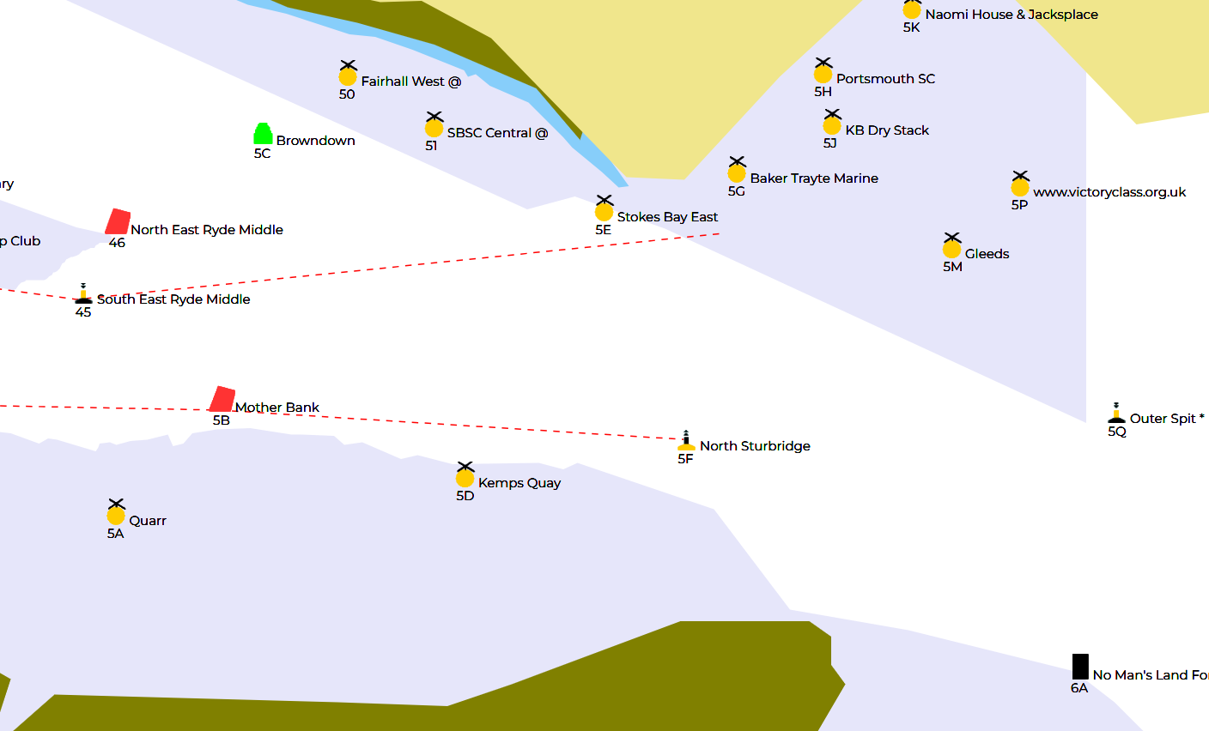
Round the Fort Course
Start (line tbc)
SBSC West (P)
NE Ryde Middle (P)
Mother Bank (P)
No Man’s Land Fort (P)
Stokes Bay East (P)
Finish

